Slide 1
Lecture 2: Activity Diagrams
CoTaPP: Computational Thinking and Programming with Python

Slide 2

Lectures will be recorded from today
Only students from the course will have access to the recordings
Be aware of this if you don’t want to be in the recording

Slide 3
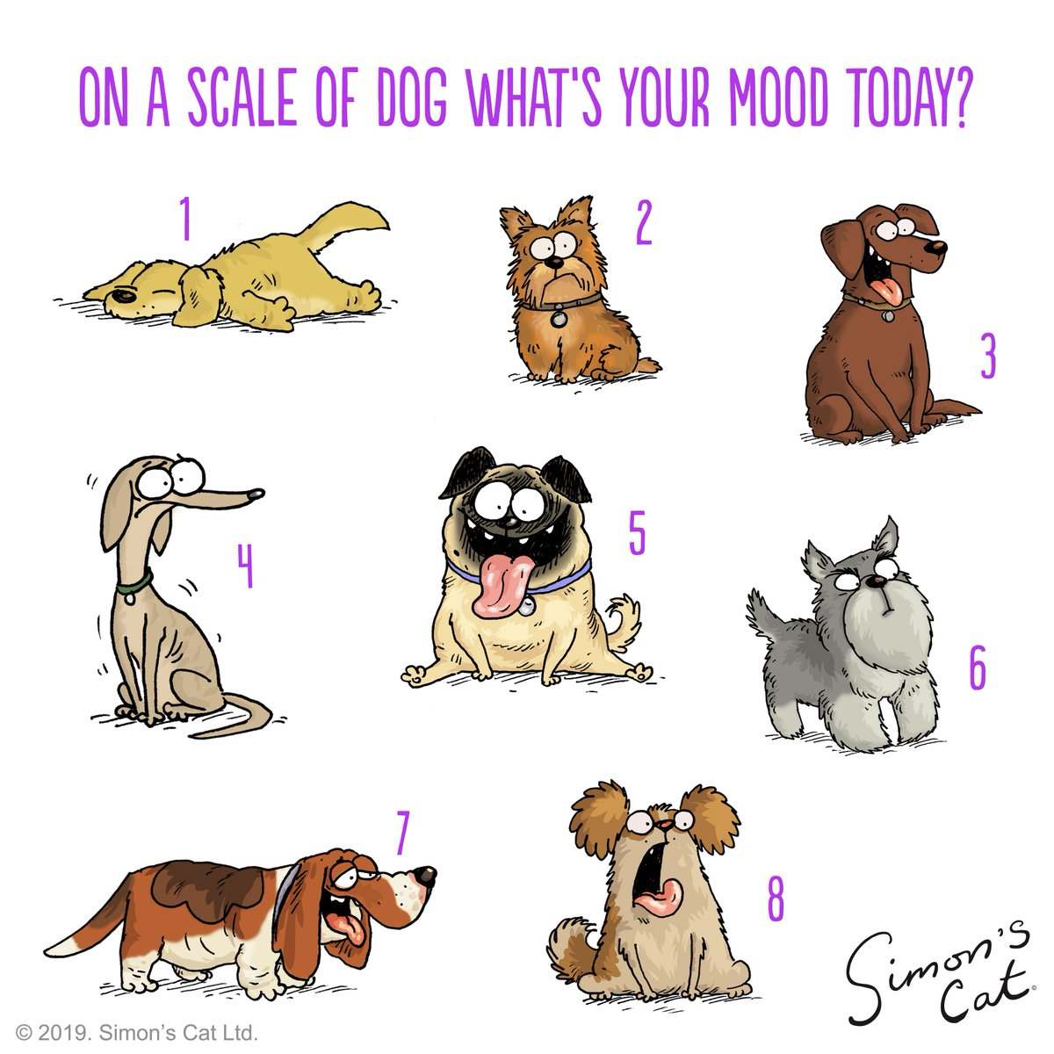

Slide 5




Slide 6

Previous lecture
Computational thinking
  It is about expressing problems and their solutions in ways that a computer (human or machine) could execute

Slide 7

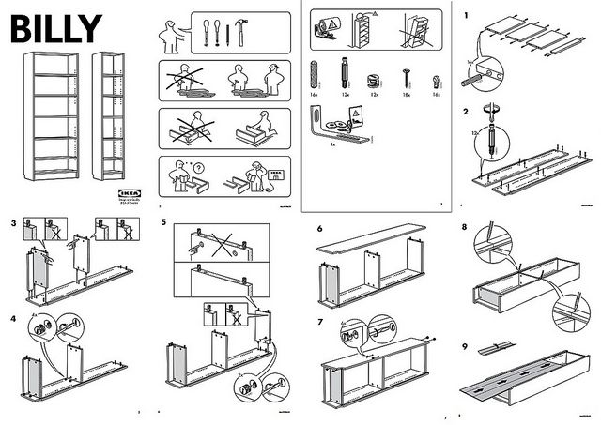
… is not trying to get humans to think like computers
… is a way humans solve problems
Robot: Spraul, V. A. (2017). Think like a programmer: A beginner's guide to programming and problem solving. No Starch Press.
Billy: https://cdn.frankwatching.com/app/uploads/2016/09/instructions_IKEA_billy-295x209.jpg

Slide 8

Previous lecture
Computational thinking
  It is about expressing problems and their solutions in ways that a computer (human or machine) could execute
Program:
  You need to know what you want to do,
  you need to tell the executing machine how to do that for you

Slide 9
Today’s lecture
Today we will look at techniques for expressing what you want to do at different levels of abstraction

Slide 10
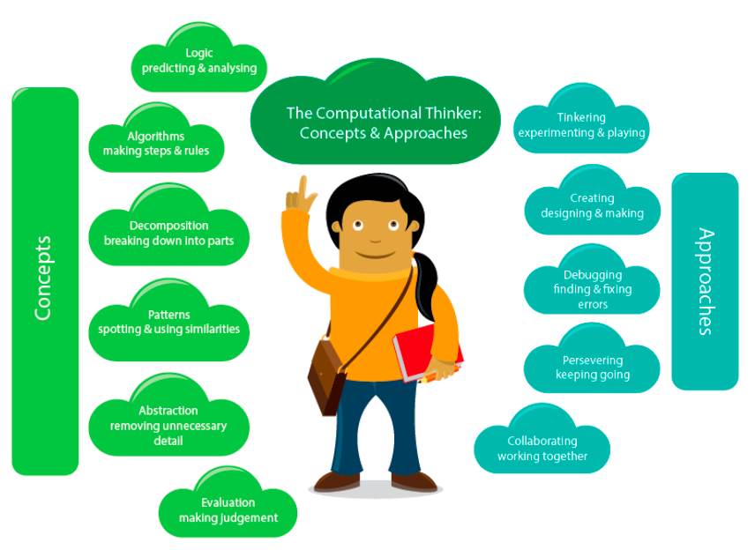
A. Csizmadia et al., "Computational thinking-A guide for teachers," 2015.

Slide 11


Slide 12

Map of the Utrecht public transport network

Slide 13
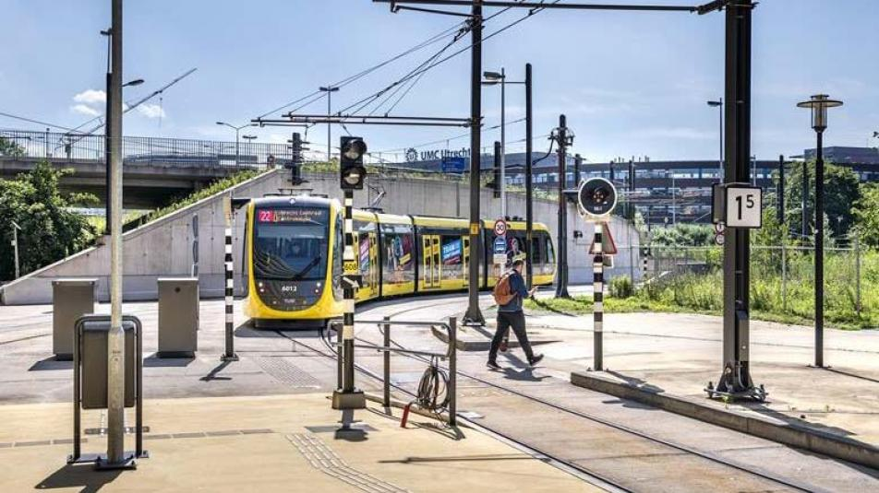
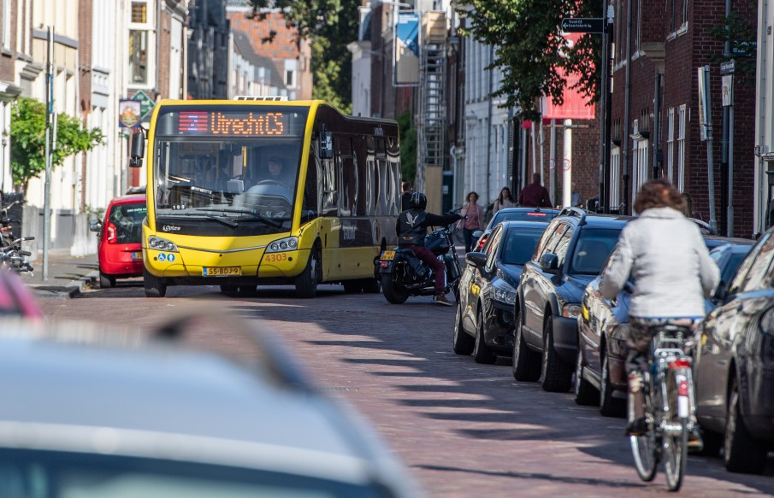

Slide 14


Slide 15
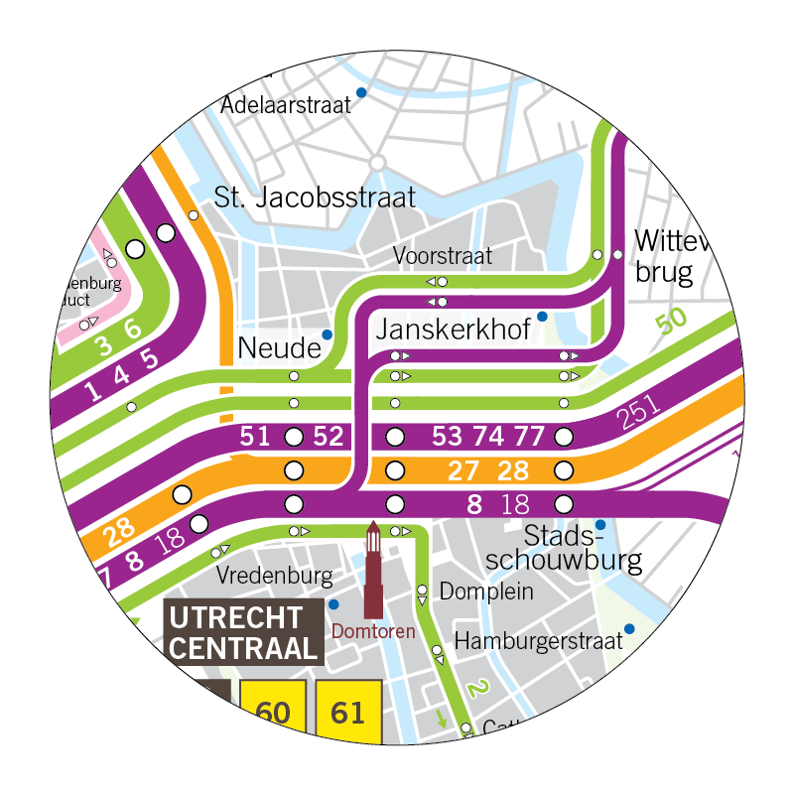

Slide 16
Abstraction → Modeling
Abstraction is formalized in such a way that it can serve as guidelines for the next step on the way to actually write useful software
We also say that we design or model the program before we implement it
Doing this is important in particular when dealing with more complex computational problems, where a good concept for a program is not easily imagined just mentally

Slide 17

Modeling Processes with Activity Diagrams
UML Activity Diagrams are a well-known technique to describe processes at different levels of abstraction.
They can for example be used for designing a data analysis process, prior to its implementation in a concrete programming language like Python.

Slide 18
Modeling Processes with Activity Diagrams
UML Activity Diagrams describe processes:
  the sequencing of activities
  conditional and parallel behaviors.
They are particularly useful for workflow modeling and behavioral descriptions of programs

Slide 19



Slide 20

(sequential execution): How to cook Heinz Beanz in the microwave

Slide 21
(sequential execution): How to cook Heinz Beanz in the microwave
“Empty contents into a microwaveable container and cover. Heat on full power for 1 ½ minutes. Stir. Heat for a further 1 minute.”

Slide 22

(sequential execution): How to cook Heinz Beanz in the microwave
“Empty contents into a microwaveable container and cover. Heat on full power for 1 ½ minutes. Stir. Heat for a further 1 minute.”
start point of the process (black dot)

Slide 23
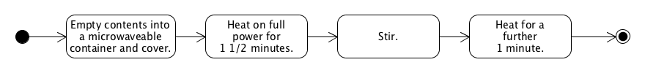
(sequential execution): How to cook Heinz Beanz in the microwave
“Empty contents into a microwaveable container and cover. Heat on full power for 1 ½ minutes. Stir. Heat for a further 1 minute.”
activity (the rounded rectangles)

Slide 24
(sequential execution): How to cook Heinz Beanz in the microwave
“Empty contents into a microwaveable container and cover. Heat on full power for 1 ½ minutes. Stir. Heat for a further 1 minute.”
transitions denoted by the arrows between the activity nodes

Slide 25
(sequential execution): How to cook Heinz Beanz in the microwave
“Empty contents into a microwaveable container and cover. Heat on full power for 1 ½ minutes. Stir. Heat for a further 1 minute.”

Slide 26
(sequential execution): How to cook Heinz Beanz in the microwave
“Empty contents into a microwaveable container and cover. Heat on full power for 1 ½ minutes. Stir. Heat for a further 1 minute.”

Slide 27
(sequential execution): How to cook Heinz Beanz in the microwave
“Empty contents into a microwaveable container and cover. Heat on full power for 1 ½ minutes. Stir. Heat for a further 1 minute.”
end point of the process (black dot with the white circle)

Slide 28

(parallel execution): How to prepare pasta with tomato sauce

Slide 29
(parallel execution): How to prepare pasta with tomato sauce
“Buy pasta and tomato sauce. Bring 2 liters of water to the boil in a large pot. Add pasta. Cook for 10 min. Strain pasta. In the meantime put tomato sauce into a small pot. Heat slowly. Put pasta and tomato sauce onto a plate. Enjoy!”

Slide 30

(parallel execution): How to prepare pasta with tomato sauce
“Buy pasta and tomato sauce. Bring 2 liters of water to the boil in a large pot. Add pasta. Cook for 10 min. Strain pasta. In the meantime put tomato sauce into a small pot. Heat slowly. Put pasta and tomato sauce onto a plate. Enjoy!”

Slide 31
(parallel execution): How to prepare pasta with tomato sauce
“Buy pasta and tomato sauce. Bring 2 liters of water to the boil in a large pot. Add pasta. Cook for 10 min. Strain pasta. In the meantime put tomato sauce into a small pot. Heat slowly. Put pasta and tomato sauce onto a plate. Enjoy!”

Slide 32
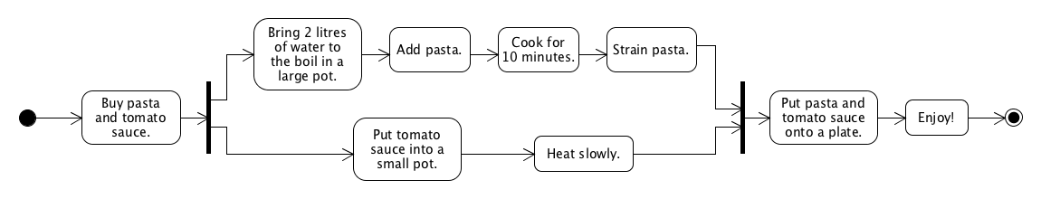
(parallel execution): How to prepare pasta with tomato sauce
“Buy pasta and tomato sauce. Bring 2 liters of water to the boil in a large pot. Add pasta. Cook for 10 min. Strain pasta. In the meantime put tomato sauce into a small pot. Heat slowly. Put pasta and tomato sauce onto a plate. Enjoy!”

Slide 33
(parallel execution): How to prepare pasta with tomato sauce
“Buy pasta and tomato sauce. Bring 2 liters of water to the boil in a large pot. Add pasta. Cook for 10 min. Strain pasta. In the meantime put tomato sauce into a small pot. Heat slowly. Put pasta and tomato sauce onto a plate. Enjoy!”
the black bar denotes forks (splitting one transition into several ones)

Slide 34
(parallel execution): How to prepare pasta with tomato sauce
“Buy pasta and tomato sauce. Bring 2 liters of water to the boil in a large pot. Add pasta. Cook for 10 min. Strain pasta. In the meantime put tomato sauce into a small pot. Heat slowly. Put pasta and tomato sauce onto a plate. Enjoy!”

Slide 35
(parallel execution): How to prepare pasta with tomato sauce
“Buy pasta and tomato sauce. Bring 2 liters of water to the boil in a large pot. Add pasta. Cook for 10 min. Strain pasta. In the meantime put tomato sauce into a small pot. Heat slowly. Put pasta and tomato sauce onto a plate. Enjoy!”
the black bar denotes joins (joining several transitions into one)

Slide 36
(parallel execution): How to prepare pasta with tomato sauce
“Buy pasta and tomato sauce. Bring 2 liters of water to the boil in a large pot. Add pasta. Cook for 10 min. Strain pasta. In the meantime put tomato sauce into a small pot. Heat slowly. Put pasta and tomato sauce onto a plate. Enjoy!”

Slide 37

(conditional execution): How to get your morning coffee as you like it

Slide 38
(conditional execution): How to get your morning coffee as you like it
“Make coffee. Add milk? If yes, add milk. Add sugar? If yes, add sugar. Enjoy!”

Slide 39
(conditional execution): How to get your morning coffee as you like it
“Make coffee. Add milk? If yes, add milk. Add sugar? If yes, add sugar. Enjoy!”

Slide 40
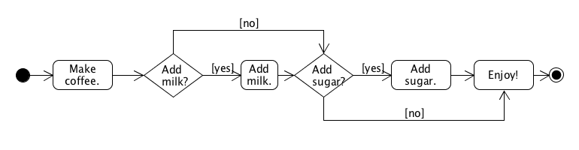
(conditional execution): How to get your morning coffee as you like it
“Make coffee. Add milk? If yes, add milk. Add sugar? If yes, add sugar. Enjoy!”

Slide 41
(conditional execution): How to get your morning coffee as you like it
“Make coffee. Add milk? If yes, add milk. Add sugar? If yes, add sugar. Enjoy!”
the diamond is used to model conditional behavior

Slide 42
(conditional execution): How to get your morning coffee as you like it
“Make coffee. Add milk? If yes, add milk. Add sugar? If yes, add sugar. Enjoy!”
only one of the outgoing transitions will be taken during execution,
depending on the result of the evaluation at the node (the diamond)

Slide 43
(conditional execution): How to get your morning coffee as you like it
“Make coffee. Add milk? If yes, add milk. Add sugar? If yes, add sugar. Enjoy!”

Slide 44
(conditional execution): How to get your morning coffee as you like it
“Make coffee. Add milk? If yes, add milk. Add sugar? If yes, add sugar. Enjoy!”

Slide 45

(pre-test loop): How to season your dish from the canteen

Slide 46
(pre-test loop): How to season your dish from the canteen
“Get dish. Does it need extra salt? If yes, add a bit of salt and go back to checking again. If not, enjoy!”

Slide 47
(pre-test loop): How to season your dish from the canteen
“Get dish. Does it need extra salt? If yes, add a bit of salt and go back to checking again. If not, enjoy!”

Slide 48
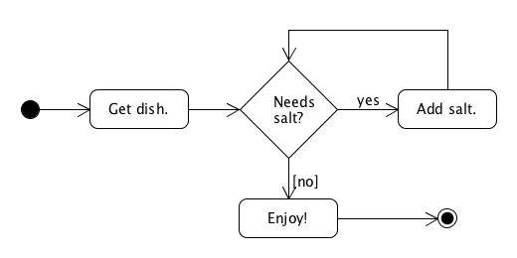
(pre-test loop): How to season your dish from the canteen
“Get dish. Does it need extra salt? If yes, add a bit of salt and go back to checking again. If not, enjoy!”

Slide 49
(pre-test loop): How to season your dish from the canteen
“Get dish. Does it need extra salt? If yes, add a bit of salt and go back to checking again. If not, enjoy!”
A successor transaction backs to the condition (diamond) → (pre-test) loop that repeatedly executes the activities in the loop’s body as long as the condition is met.

Slide 50
(pre-test loop): How to season your dish from the canteen
“Get dish. Does it need extra salt? If yes, add a bit of salt and go back to checking again. If not, enjoy!”

Slide 51

(post-test loop): How to eat up a bag of marshmallows

Slide 52
(post-test loop): How to eat up a bag of marshmallows
“Open bag. Take marshmallow. Eat it. Are there any marshmallows left? If yes, go back to taking one. If not, dispose of bag.

Slide 53
(post-test loop): How to eat up a bag of marshmallows
“Open bag. Take marshmallow. Eat it. Are there any marshmallows left? If yes, go back to taking one. If not, dispose of bag.

Slide 54
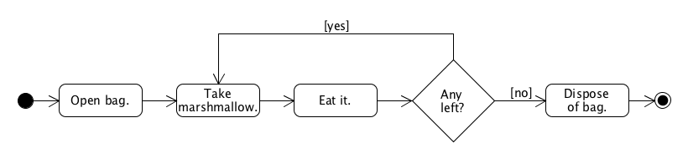
(post-test loop): How to eat up a bag of marshmallows
“Open bag. Take marshmallow. Eat it. Are there any marshmallows left? If yes, go back to taking one. If not, dispose of bag.

Slide 55
(post-test loop): How to eat up a bag of marshmallows
“Open bag. Take marshmallow. Eat it. Are there any marshmallows left? If yes, go back to taking one. If not, dispose of bag.
the diamond is used to model a post-test loop. The condition at the diamond is used to transition back to a previous process step in one case

Slide 57
“Make coffee. Add milk? If yes, add milk. Add sugar? If yes, add sugar. Enjoy!”
You want to save some money. So you can only add milk or sugar, but not both

Slide 58
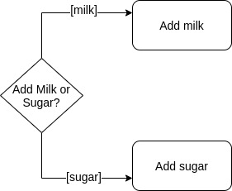
“Make coffee. Add milk? If yes, add milk. Add sugar? If yes, add sugar. Enjoy!”
You want to save some money. So you can only add milk or sugar, but not both

Slide 59
“Make coffee. Add milk? If yes, add milk. Add sugar? If yes, add sugar. Enjoy!”
You want to save some money. So you can only add milk or sugar, but not both
Not recommended → yes or no questions

Slide 60
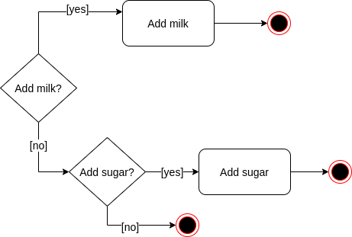
“Make coffee. Add milk? If yes, add milk. Add sugar? If yes, add sugar. Enjoy!”
You want to save some money. So you can only add milk or sugar, but not both

Slide 61

(data objects and swimlanes): Document Management Process

Slide 62
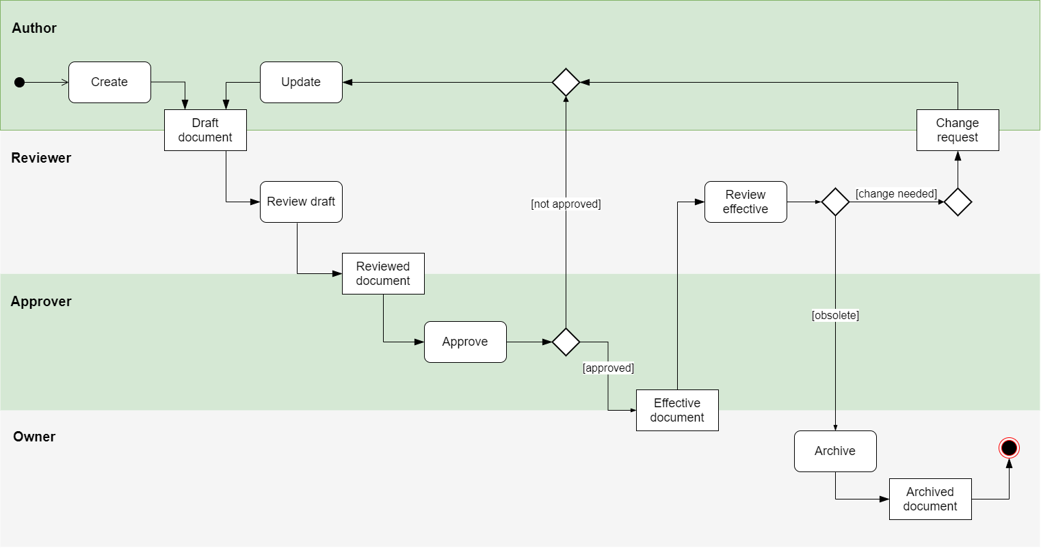
(data objects and swimlanes): Document Management Process

Slide 63
(data objects and swimlanes): Document Management Process

Slide 64
(data objects and swimlanes): Document Management Process
non-rounded rectangles → represent data objects during the process (optional)

Slide 65
(data objects and swimlanes): Document Management Process
“swimlanes” → distinguish the activities of different actors (collaborative processes)

Slide 66

(hierarchical diagrams): Web Shop

Slide 67
(hierarchical diagrams): Web Shop
When processes get larger and more complex, it is useful to organize Activity Diagrams hierarchically.

Slide 68
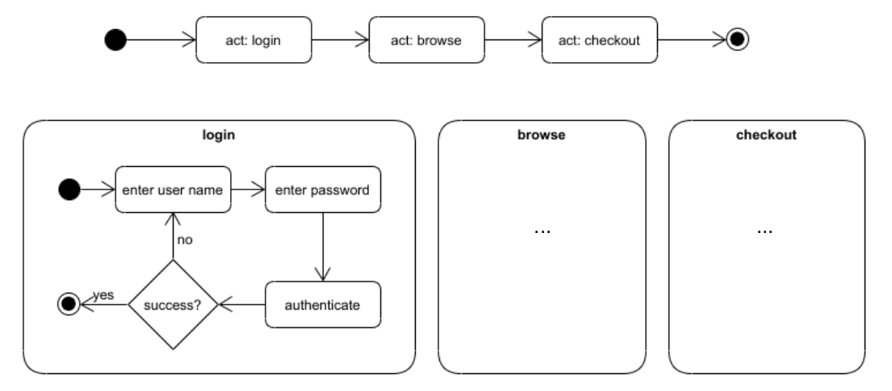
(hierarchical diagrams): Web Shop
When processes get larger and more complex, it is useful to organize Activity Diagrams hierarchically.
web shop process

Slide 69
(hierarchical diagrams): Web Shop
When processes get larger and more complex, it is useful to organize Activity Diagrams hierarchically.
web shop process
top-level process

Slide 70
(hierarchical diagrams): Web Shop
When processes get larger and more complex, it is useful to organize Activity Diagrams hierarchically.
web shop process
top-level process

Slide 71
Sub-diagrams
Sub-diagrams can refer to other sub-diagrams again
  there is no limit to the number of hierarchies that one can use
  A general rule of thumb is that it should not be more than 5-7
It is possible to re-use Activity Diagrams in more than one place in other diagrams
  the login functionality may be required at different points of a more complex web shop process
  we could then simple write "act: login" in the activity node

Slide 73
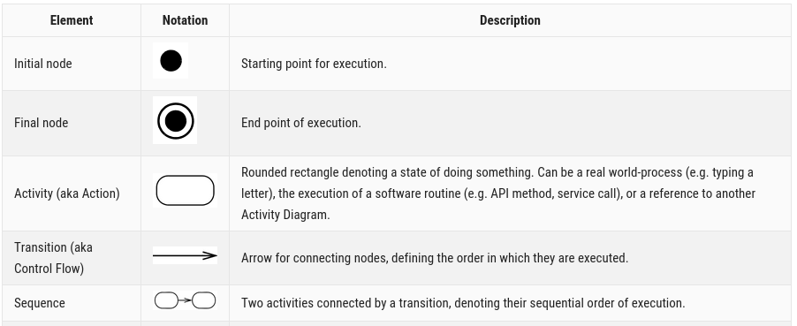

Slide 74
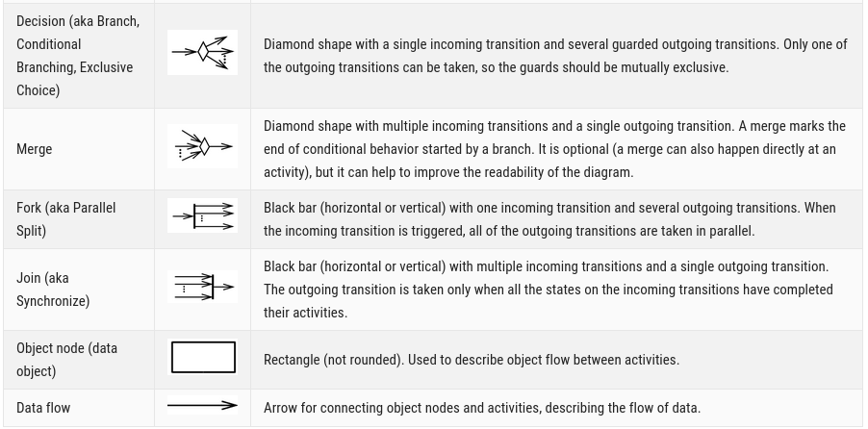

Slide 76
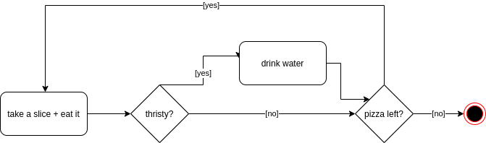
You get a pizza. You take a slice. After you eat it, you ask yourself is your are thirsty. If yes, drink some water. You continue eating the pizza until the box is empty.

Slide 77
Making diagrams
https://app.diagrams.net/
  general and UML shapes

Slide 78
Next lecture
Start with Python
  Learn how to translate these plans or designs further into a language that the computer will be able to understand
MasteryGrids introduction

Slide 79
To Do
Exercises for the week
  Use quarterfall to submit them
Python up and running
  You can run jupyter notebooks
  Test with the one for the next lecture → “03 Getting Started with Python.ipynb”
  Q&A sessions

